Slide 1



BIODIVERSITY ANALYSIS
On NPS Conservation Status of Species
Jing Zhao
bea

Slide 2
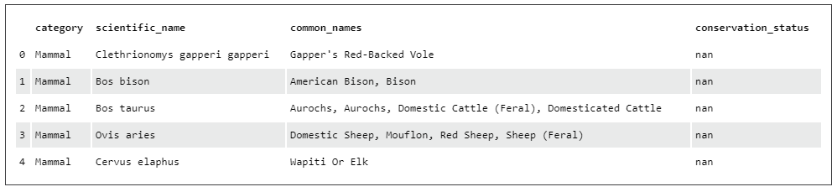
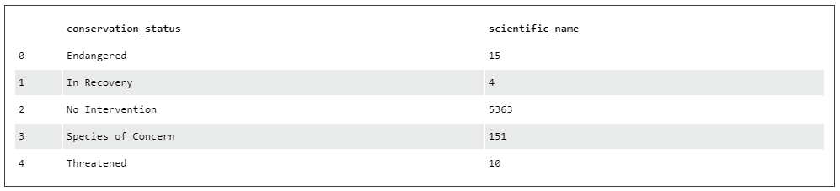
species_info.csv
About the Data
The data we need to conduct the analysis are stored in a csv file called species_info.csv. It has four columns: ‘category’, ‘scientific_name’, ‘common_names’, and ‘conservation_status’.
The database recorded 7 species (in the ‘category’ column) and 5541 different scientific names (in the ‘scientific_name’ column). Under the ‘conservation_status’ column, we notice that some records have ‘NaN’ as values. By grouping the ‘scientific_name’ and counting the number of records under each ‘conversation_status’, we can see all the conversation status categories and the number of records in each category.
Findings:
There are five categories of conversation status in the database – ‘endangered’, ‘in recovery’, ‘no intervention’, ‘species of concern’, and ‘threatened’.

Slide 3
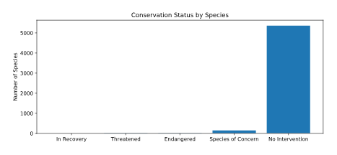
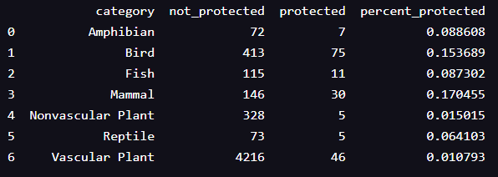
ENDANGERED Status
Across all species
Question –
“Are certain types of species more likely to be endangered?"
Species of Concern: declining population or appears to be in need of conservation. – ‘protected’
Threatened: vulnerable to endangerment in the near future.
Endangered: seriously at risk of extinction. – ‘protected’
In Recovery: formerly Endangered, but currently not in danger of extinction throughout all or a significant portion of its inhabitable range. – ‘protected’
No Intervention: not in any of the above categories, and is ‘not protected’
From the pivoted table on the right, it looks like Mammals are more likely to be endangered than Birds.
Is this due to a result of chance?
Findings:
There was a slight difference in the percentages of birds and mammals that fall into a protected category.
Further investigation is needed to find out if the difference is due to a result of chance.

Slide 4
ENDanGered species
Question 1 –
“Was the slight difference in the percentages of birds and mammals that fall into a protected category a result of chance?"
Significance tests
Contingency table 1.
 | protected | not-protected
Mammal | 30 | 146
Bird | 75 | 413
Chi-Squared Test 1
Significance result: 0.687594809666
pval > 0.05
NO SIGNIFICANT DIFFERENCE!
Question 2 –
“Was the slight difference in the percentages of reptiles and mammals that fall into a protected category a result of chance?"
Contingency table 2.
 | protected | not-protected
Mammal | 30 | 146
Reptile | 75 | 413
Chi-Squared Test 2
Significance result: 0.0383555902297
pval < 0.05
SIGNIFICANT DIFFERENCE!
Findings:
Certain types of species are more likely to be endangered than others.

Slide 5
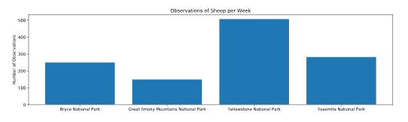
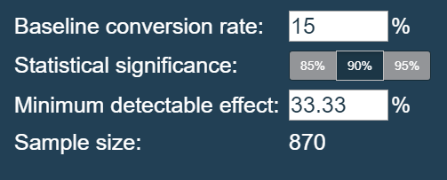
Sample size DETERMINATION
For the foot and mouth disease study
Table: Observations by Parks
Graph: Observations of Sheep per Week
 | Park Name | Observations per Week
0 | Bryce National Park | 250
1 | Great Smoky Mountains National Park | 149
2 | Yellowstone National Park | 507
3 | Yosemite National Park | 282
Facts:
Last year it was recorded that 15% of sheep at Bryce National Park have foot and mouth disease.
The scientists want to be able to detect reductions of at least 5 percentage points.
Use the default level of significance (90%).
Findings:
Given a baseline of 15% occurrence of foot and mouth disease in sheep at Bryce National Park, if the scientists wanted to be sure that a >5% drop in observed cases of foot and mouth disease in the sheep at Yellowstone was significant, they would have to observe at least 870 sheep.
Using the observation data, this would take approximately one week of observing in Yellowstone to see that many sheep, or approximately two weeks in Bryce to see that many sheep.

